Slide 2
UNIT 4:
THE MASS MEDIA
Lesson 2: Language

Slide 3
https://quizlet.com/420871508/g12-unit-4-language-vocabulary-flash-cards/
A- VOCABULARY

Slide 4
Act 1. Match words and phrases with definitions
1. unable to stop doing something because you like it very much
2. the use of websites and applications to connect with people who share similar interests
3. the main means of communication reaching people on a large scale, such as television, radio, movies, newspapers, etc.
4. a type of real-time online chat
5. doing something well with no waste of time, money, or energy
6. the use of electronic communication to hurt, threaten or embarrass someone

Slide 5
Act 2. Complete the sentences with the words/phrases
1. Most people rely heavily on __________________ as their main source of information.
2. Millions of teenagers around the world are ____________ to computer and video games.
3. Teenagers can become addicted to ___________________ if they can’t control the time they spend online.
4. Online advertising is more ______________ than TV ads because of the huge number of Internet users.
5. Young people like _______________________ because of its speed, convenience and privacy.
6. Many Internet users delete their social accounts because of
_____________________.
the mass media
addicted
social networking
efficient
instant messaging
cyberbullying

Slide 6
The ways to pronounce _ed at the end of ordinary verbs
Cách đọc | Âm cuối | Ví dụ
/ d /
(các âm còn lại ngoài 2 nguyên tắc riêng dưới đây)
answered, played, begged, allowed
(nguyên tắc chung)
/ ɪd /
d, t
visited, needed, mended, wanted
(nguyên tắc riêng 1)
(đạn tịt)
k, x, s, p, ch, sh, f
looked, faxed, passed, stopped, watched, washed, laughed
/ t /
(nguyên tắc riêng 2)
[khi xuống sông phải coi chừng cô ấy (she) té (falls)]

Slide 7
B- PRONUNCIATION
Act 1. LISTEN AND REPEAT
reduced | used | copied
received | distributed | welcomed
developed | influenced | invented
introduced | provided | downloaded

Slide 8
Act 2. LISTEN AND REPEAT THE SENTENCES
1. The library reduced the number of print newspapers and magazines that they used to subscribe to.
2. The graph compares the amount of information received over a ten-year period.
3. Have you downloaded the files related to our social media project, which I emailed you yesterday?
4. Paper was invented before the printing machine.
5. New electronic devices have been developed to cater to users’ ever-changing needs.
6. Social networking has inﬂuenced young people’s way of life.

Slide 9
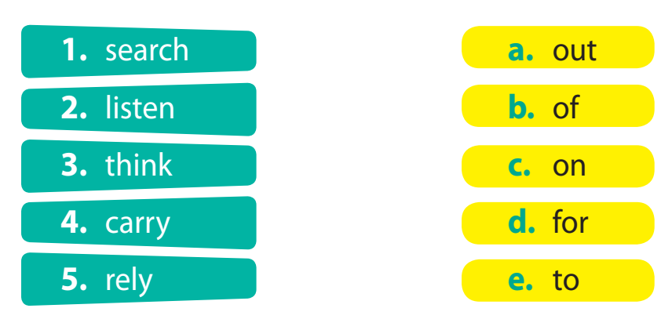
C- GRAMMAR
I. Prepositions after some verbs
Act 1. Match the verb with an appropriate preposition

Slide 10
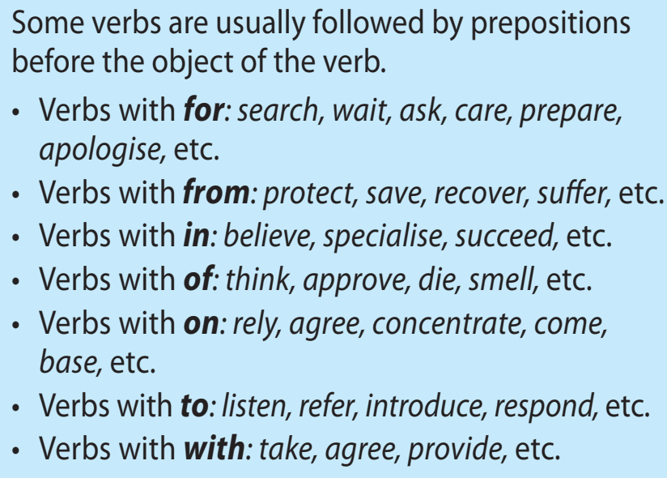

Slide 11
Act 2. Choose the best answer
1. Terry always depends _______ his brother for assistance.
A. on B. in C. at D. of
2. While I’m waiting ______ my bus, I often listen _____ music.
A. upon - in B. on - at C. toward - about D. for - to
3. He doesn’t want to refer ___ his problems with anybody. He thinks he can deal ___ them himself.
A. in - to B. over - to C. than - on D. to - with
4. You can never rely ____ Anna to provide you ____ information.
A. of - with B. for - to C. on - with D. on - by
5. He apologized ___ his parents ___ having played video games overnight without any permission.
A. to - for B. with - on C. to - about D. of - to

Slide 12
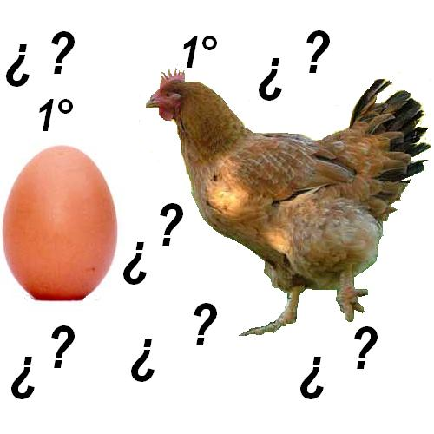
WHAT HAPPENED FIRST?

Slide 13
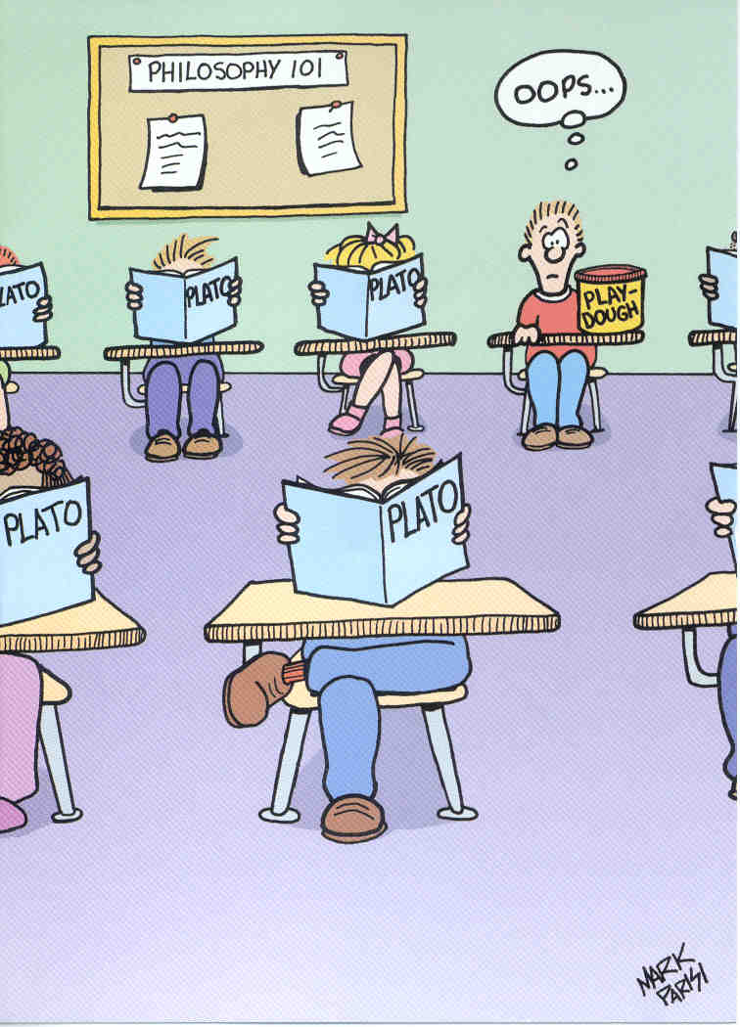
When Kevin arrived to school the class had already started

Slide 14
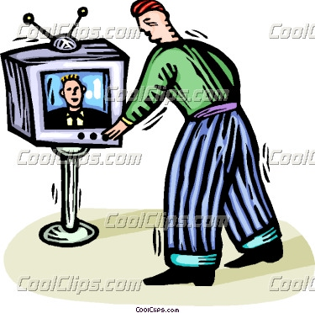
When he turned on the TV, the program had already started

Slide 15
When Paul got home, he realized he had left the door open.

Slide 16
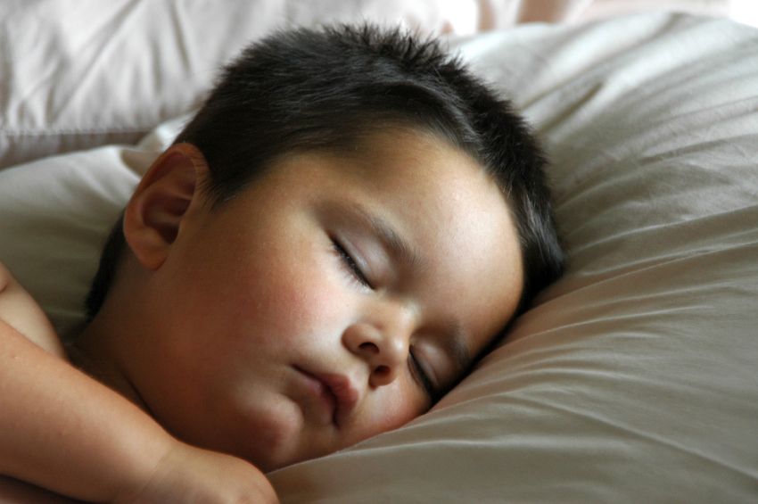
After my son had gone to bed, I watched a movie.

Slide 17
C- GRAMMAR
II. The past perfect and the past simple

Slide 19
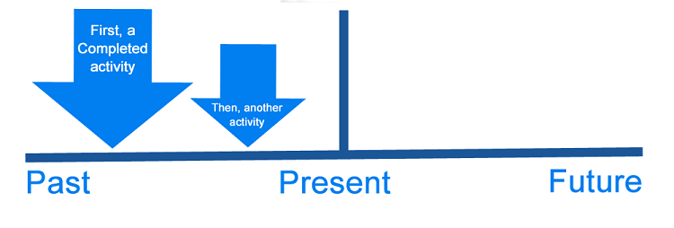
By the time Tony got to the bus stop, the bus had already left
➔ To show that an action happened before something else in the past (diễn tả 1 hành động xảy ra trước một điều gì ở trong quá khứ)

Slide 20
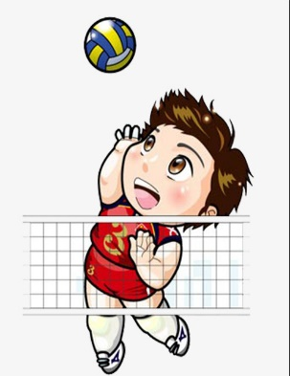
Minh had never played volleyball before 2018.
had never played
2018
➔ To show that an action happened before a specific time in the past (diễn tả 1 hành động xảy ra trước một thời điểm cụ thể ở quá khứ)

Slide 21
TIME EXPRESSIONS
After (sau khi)
As soon as (ngay khi)
Until (cho tới khi)
By the time (ngay khi)
Before (trước khi)
When (khi)

Slide 22
By the time (ngay khi)
Before (trước khi)
When (khi)
Ex.
Before I knew it, she had run out the door.
By the time he phoned her, she had turned off her cellphone.
She had left when I got home.
+ S + V2/ed
, S + had + V3/ed

Slide 23
After (sau khi)
As soon as (ngay khi)
Until (cho tới khi)
Ex.
After she had moved out, I found her notes.
I didn’t say anything until she had finished talking.
As soon as I had finished my homework, I went to bed.
+ S + had + V3/ed
, S + V2/ed

Slide 24
had invented
1. Alexander Graham Bell (invent) _____________ the telephone when Thomas Edison (complete) ___________ his second model of the phonograph in 1887.
completed

Slide 25
Act 1. Put the verbs in brackets in the correct tenses.
2. National Geographic, one of the most influential magazines, (appear)_______________ in 1899, which (help)____________ to increase readers’ cultural awareness and understanding through high-quality photo essays.
3. The lung cancer mortality rate (rise)_________________six-fold in males when mass media (start)________________ covering the health risks of smoking.
4. Linda only (understand)_____________the film after she (read)__________________ the book.
appeared
helped
had risen
started
understood
had read

Slide 26
Had
appeared
5. A: ________you ever (appear)__________on TV before you (take part)______________in this reality show?
B: Yes, I (have)_________________.
6. I can’t believe I (get)___________the position of a TV announcer. I (submit) _______________ my application two months ago, but I did not think I had a chance getting it. When I (show) _____________ up at the interview, there were at least fifteen people who (arrive) _________________ before me.
7. All job applicants (finish, already)_________________ their interviews and (leave)_________when I (arrive)__________.
took part
had
got
submitted
showed
had arrived
had already finished
left
arrived

Slide 27
Act 2. Complete the following sentences, using either the past simple or past perfect, and your own ideas.
1. Minh’s grandpa got a laptop after he ____________________.
2. Nam had already downloaded the information for his essay when his classmate Lucy ____________________.
3. When I logged into my social media account, my friends .
4. After the students had carried out a survey on the use of the internet and analysed the related data, ____________________.
5. Lan had spent three days doing research on social media when ____________________.
6. After Ninh had drawn the graph to compare the two social networking sites, ____________________.

Slide 28
1. Minh’s grandpa got a laptop after he had used the library’s computer to get access to the Internet.
2. Nam had already downloaded the information for his essay when his classmate Lucy rang his doorbell.
3. When I logged into my social media account, my friends started sending me their greetings / had already posted their greetings for my birthday.
4. After the students had carried out a survey on the use of the internet and analysed the related data, they began drawing their charts.
5. Lan had spent three days doing research on social media when the teacher changed the topic.
6. After Ninh had drawn the graph to compare the two social networking sites, he wrote a brief description of the data.

Slide 29
EXTRA EXERCISES
1- After I ______ (finish) my lunch, I went back to work.
2- George ________ (repair) his car before he went fishing.
3- She _______ (tell) me she _________ (buy) a new car.
4- I _____(buy) a new car because some thieves __________ (steal) my old one.
5- After the company _____Joe, he began to work on his first project. (hire)
6 - _____you _______ the news before you saw it on TV? (hear)
7- Michael didn’t want to see the movie because he _______ the book yet. (not read)

Slide 30
8-The concert ______ already _______when we _______ the stadium. (begin/ enter)
9- Until Anne met Mark, she ____ never ______in love. (be)
10- Bill __________ for years before he finally _______. (smoke/ quit)
11- _______ Sara ever _______to London by herself before October? (drive)
12- How many fish ______ the boys _____ by the time it started raining? (catch)
13- You ________ them to go to the beach, hadn’t you? (forbid)
14- The girls _______ in weeks. That’s why they ______ so much afterwards. (not exercise / hurt)

Slide 31
Circle the correct answers. In some cases only one is correct, and in others both are correct.
As James was introduced to Mrs. Snape, he realized that he had met / met her before.

Slide 32
1. During the previous week, I had been / went to the gym every evening.
2. He denied that he had taken / took the money from the office.
3. I didn’t know the marking would take so long until I had read / read the first couple of essays.
4. The boy told me that he had lost / lost his train ticket and didn’t know how he would get home.
5. At the conference, scientists reported that they had found / found a cure for malaria.

Slide 33
7. The teacher guessed that some of the children had cheated / cheated in the exam.
8. Thomas explained that he had gone / went home early because he felt ill.
9. The waiter took my plate away before I had finished / finished eating.
10. Jane didn’t want any dinner. She had eaten / ate already.

